Slide 1
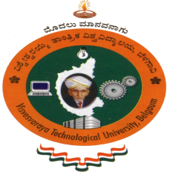
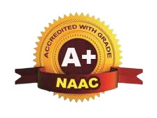

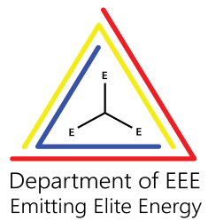



SCALABLE IOT FOR PRECISION FARMING
Presented By,
NAYANA B 4AD21EE014
PRIYANKA G 4AD21EE017
VINOD H S 4AD21EE022
HEMANTH D 4AD22EE407
Under the Guidance of,
Prof. Swathi C A
Assistant Professor
Department of Electrical & Electronics Engineering
ATME College of Engineering, Mysuru
PROJECT PHASE-I
ATME College of Engineering, Mysuru

Slide 2


Introduction
Literature Survey
Components Required
Advantages
Problem Objectives
Applications
Methodology
References
Problem Definition
Significance of NPK
Software Tools
Future Scope
Results
CONTENTS
PROJECT PHASE-I
ATME College of Engineering, Mysuru

Slide 3
Introduction
Agriculture is vital for human survival, but challenges like water scarcity, soil degradation, and climate change demand smarter farming solutions.
Precision farming, offers a transformative approach to address these issues.
This project presents an IoT-based precision farming system that integrates multiple sensors to monitor key environmental and soil parameters.
Data collected from sensors is displayed on a mobile app, providing real-time insights to farmers. The system includes an automated irrigation feature to optimize water usage.
Designed to be scalable, the system offers a cost-effective and efficient solution for sustainable farming practices.
PROJECT PHASE-I
ATME College of Engineering, Mysuru
Department of Electrical and Electronics Engineering, ATMECE, Mysuru

Slide 4
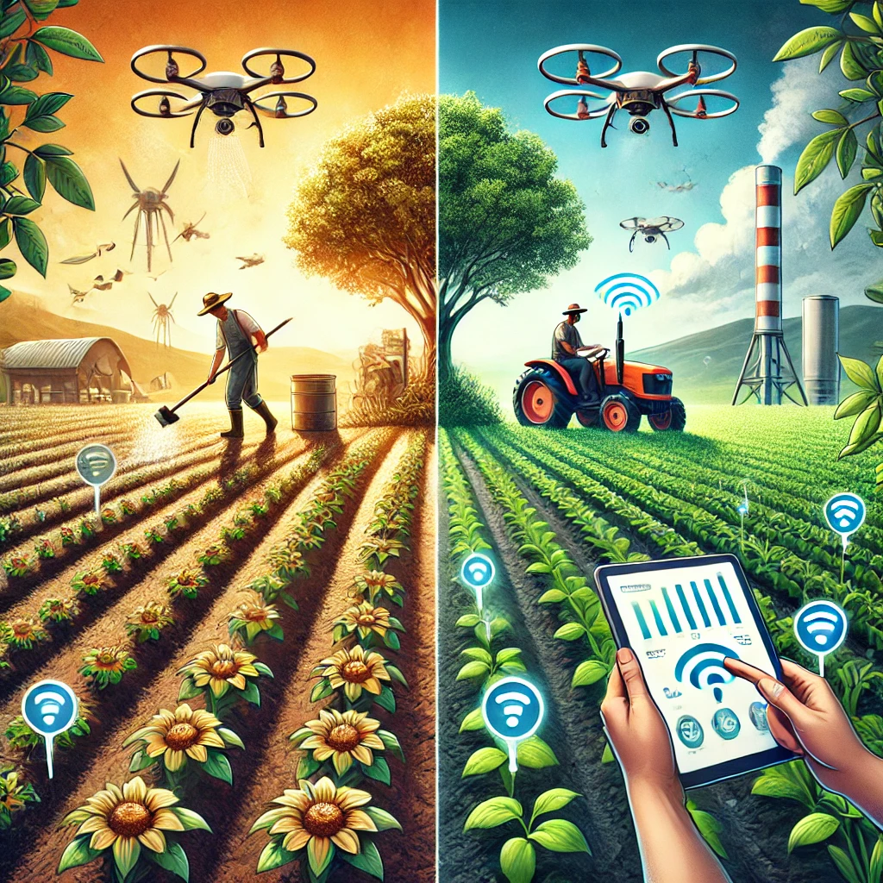
Problem Definition
Traditional farming often struggles with resource inefficiencies, unpredictable weather, and soil degradation, making it harder for farmers to achieve good yields. This project introduces an IoT-based system that helps farmers monitor temperature, humidity, soil moisture, and NPK levels in real time. With a robotic car for field data collection and a mobile app for easy control, it also automates irrigation to save water and effort. Designed to be affordable and user-friendly, this solution empowers farmers to make smarter decisions and improve productivity, bridging the gap between traditional methods and modern technology.
PROJECT PHASE-I
ATME College of Engineering, Mysuru
Department of Electrical and Electronics Engineering, ATMECE, Mysuru

Slide 5
.
Problem Objectives
To develop a real-time system for monitoring temperature, humidity, soil moisture, and NPK levels, while enabling automated irrigation via a mobile application.
To design a scalable, cost-effective solution with a robotic car for data collection, Bluetooth connectivity for easy visualization, and modular features for future expansion
PROJECT PHASE-I
ATME College of Engineering, Mysuru
Department of Electrical and Electronics Engineering, ATMECE, Mysuru

Slide 6
Literature Survey
Internet of Things for Precision Agriculture: Applications and Technologies [1] presents a detailed overview of how IoT is transforming precision agriculture by enabling real-time monitoring and control, focusing on optimizing resource use like water and fertilizers to improve crop yields.
Big Data in Smart Farming – A Review [2] explores the role of big data in agriculture, particularly how IoT devices generate large volumes of data to enhance decision-making processes, while discussing the challenges and opportunities in smart farming.
Internet of Things-IoT: Definition, Characteristics, Architecture, Enabling Technologies, Application & Future Challenges [3] introduces IoT, explaining its architecture and applications in agriculture, emphasizing how IoT aids farmers in monitoring crops and livestock to improve efficiency and reduce costs.
PROJECT PHASE-I
ATME College of Engineering, Mysuru
Department of Electrical and Electronics Engineering, ATMECE, Mysuru

Slide 7
Literature Survey
IoT Based Monitoring System for Agriculture [4] discusses the development of an IoT- based system for
real-time monitoring of soil moisture, temperature, and other factors aimed at improving irrigation efficiency
and crop health.
A Review on the Practice of Big Data Analysis in Agriculture [5] explores the potential of big data in
enhancing agricultural productivity by analyzing data collected from IoT sensors to optimize farming
operations.
Smart Irrigation System Based on Deep Learning Neural Network [6] proposes a system that combines
IoT sensors and deep learning algorithms to predict optimal irrigation schedules, improving water usage
efficiency and crop health
PROJECT PHASE-I
ATME College of Engineering, Mysuru
Department of Electrical and Electronics Engineering, ATMECE, Mysuru

Slide 8
Literature Survey
Smart Farming Revolution: Harnessing IoT for Enhanced Agricultural Yield and Sustainability [7] focuses on the transformative impact of IoT (Internet of Things) on modern agriculture. It explores how smart farming technologies, powered by interconnected sensors and devices, enable real-time monitoring of environmental factors such as soil moisture, temperature, humidity, and crop health. This real-time data allows farmers to make data-driven decisions, optimizing water usage, fertilizers, and pesticides, leading to more efficient resource management.
Monitoring and Automation in Agriculture using IoT [8] discusses the automation of processes like irrigation and pest control through IoT, showing how it reduces manual labor while enhancing farming efficiency.
Review of IoT Applications in Agro-industrial and Environmental Fields [9] reviews IoT applications in agriculture, emphasizing its use in soil analysis, weather forecasting, and smart greenhouse management while highlighting environmental benefits.
A Survey on Applications of IoT in Precision Agriculture [10] explores various IoT technologies used for monitoring soil, weather, and crop conditions, addressing challenges such as scalability, energy efficiency, and data security in IoT-based systems
PROJECT PHASE-I
ATME College of Engineering, Mysuru
Department of Electrical and Electronics Engineering, ATMECE, Mysuru

Slide 9
Significance of NPK in Agriculture
Crop | Duration (Months) | NPK Ratio (kg/ha) | Key Notes
Sugarcane | 12-15 | 300:100:200 (Sugar Mills), 225:62.5:200 (Jaggery) | High N for growth, urea: 1-2.5%
Wheat | 4-5 | 120:50:40 | High nitrogen for protein, moderate P and K for growth.
Rice | 4-5 | 100:60:40 | Balanced NPK ensures good yield and grain quality.
Maize | 3-4 | 150:60:40 | High N demand for rapid growth.
Cotton | 5-6 | 80:40:40 | Phosphorus supports flowering; K enhances fiber strength.
Soybean | 4-5 | 20:50:40 | Requires less nitrogen due to nitrogen-fixing capability.
Groundnut | 3-4 | 20:40:40 | Requires phosphorus for pod development.
Tomato | 3-4 | 120:50:100 | High K essential for fruit formation.
Potato | 3-4 | 100:60:120 | Requires high potassium due to tuber quality.
Banana | 9-12 | 200:50:200 | High N and K for growth and fruit quality.
PROJECT PHASE-I
ATME College of Engineering, Mysuru
Department of Electrical and Electronics Engineering, ATMECE, Mysuru
Notes:
Processor: Quad-core Cortex-A72 (ARM v8) 64-bit SoC @ 1.5GHz
RAM: 2GB LPDDR4-3200 SDRAMGraphics:VideoCore VI GPU
Supports dual 4K display output via dual micro-HDMI ports
Connectivity:2.4GHz and 5.0GHz IEEE 802.11b/g/n/ac wireless LAN (Wi-Fi)
Bluetooth 5.0, BLE
Gigabit Ethernet
Ports:2 × USB 3.0 and 2 × USB 2.0 ports
2 × micro-HDMI ports (supports dual 4K monitors)
40-pin GPIO header (backward-compatible with previous models)
Storage:MicroSD slot for OS and data storage
USB boot capability (from USB storage)
Other:CSI and DSI ports for camera and display connection
5V/3A USB-C power input
Supports PoE (Power over Ethernet) with PoE HAT (sold separately)
Arduino Uno: A versatile microcontroller board based on the ATmega328P, operating at 5V with a 16 MHz clock. It features 14 digital I/O pins, 6 analog inputs, and memory capacities of 32 KB Flash, 2 KB SRAM, and 1 KB EEPROM. Commonly used in prototyping, robotics, and IoT projects due to its ease of use and reliability.

Slide 10
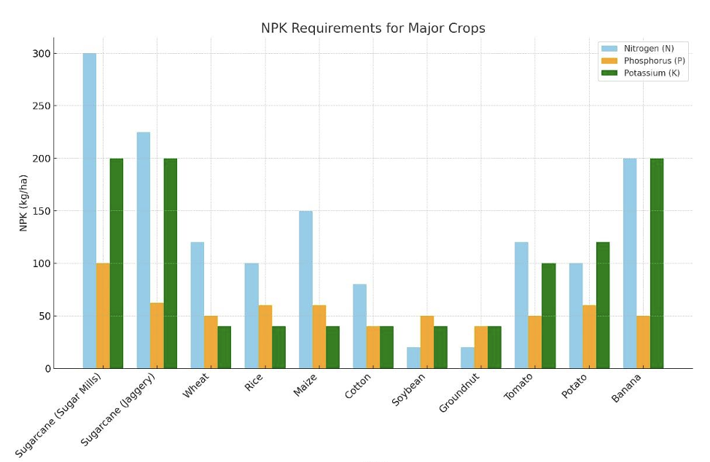
Significance of NPK in Agriculture
PROJECT PHASE-I
ATME College of Engineering, Mysuru
Department of Electrical and Electronics Engineering, ATMECE, Mysuru

Slide 11
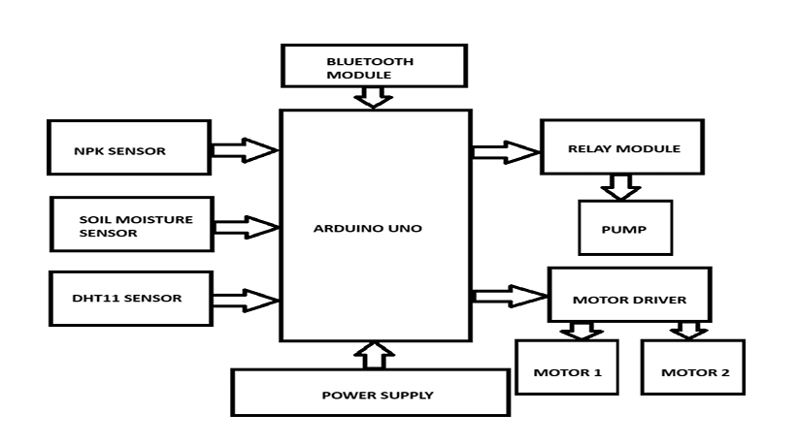

METHODOLOGY
PROJECT PHASE-I
ATME College of Engineering, Mysuru
Department of Electrical and Electronics Engineering, ATMECE, Mysuru
Notes:
The system's core components include a temperature sensor, humidity sensor, NPK sensor, and soil moisture sensor mounted on a robotic car. The car's mobility allows it to traverse the field, collecting data from different locations, ensuring comprehensive monitoring
The sensors are connected to a microcontroller (Arduino or NodeMCU), which processes the data and transmits it via Bluetooth to a mobile application. The mobile app serves as the user interface, displaying real-time values of temperature, humidity, soil moisture, and nutrient levels in a clear and accessible format.
Arduino Uno: A versatile microcontroller board based on the ATmega328P, operating at 5V with a 16 MHz clock. It features 14 digital I/O pins, 6 analog inputs, and memory capacities of 32 KB Flash, 2 KB SRAM, and 1 KB EEPROM. Commonly used in prototyping, robotics, and IoT projects due to its ease of use and reliability.

Slide 12
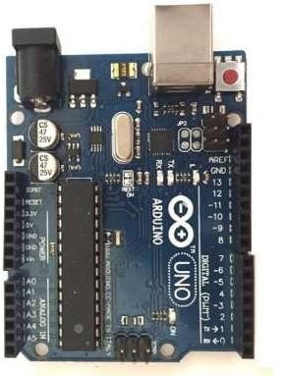
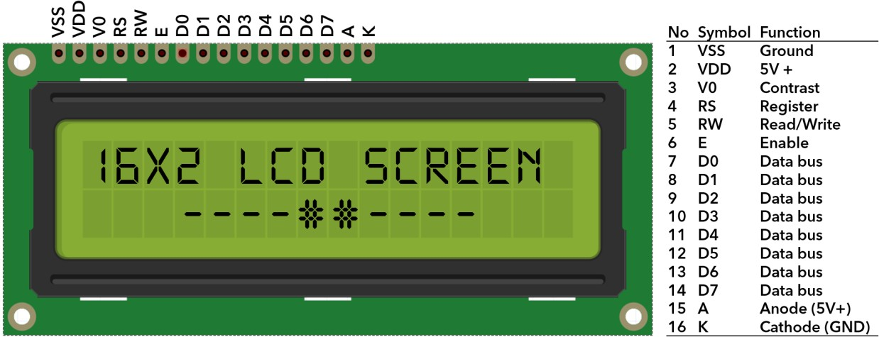
COMPONENTS REQUIRED
ARDUINO UNO
LCD DISPLAY
PROJECT PHASE-I
ATME College of Engineering, Mysuru
Department of Electrical and Electronics Engineering, ATMECE, Mysuru
Notes:
Arduino Uno: A versatile microcontroller board based on the ATmega328P, operating at 5V with a 16 MHz clock. It features 14 digital I/O pins, 6 analog inputs, and memory capacities of 32 KB Flash, 2 KB SRAM, and 1 KB EEPROM. Commonly used in prototyping, robotics, and IoT projects due to its ease of use and reliability.

Slide 13
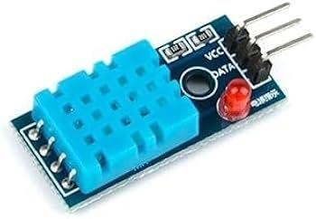
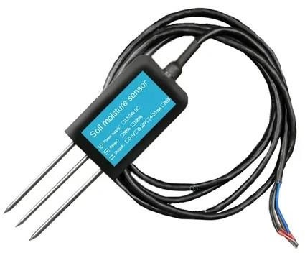
COMPONENTS REQUIRED
DHT11-Temperature and Humidity Sensor
NPK Sensor
PROJECT PHASE-I
ATME College of Engineering, Mysuru
Department of Electrical and Electronics Engineering, ATMECE, Mysuru
Notes:
The 11-in-1 NPK Sensor measures key soil parameters: Nitrogen (N), Phosphorus (P), Potassium (K), pH, temperature, moisture, electrical conductivity (EC), light intensity, humidity, air temperature, and soil salinity. It’s used in agriculture for monitoring soil health and optimizing plant growth.

Slide 14
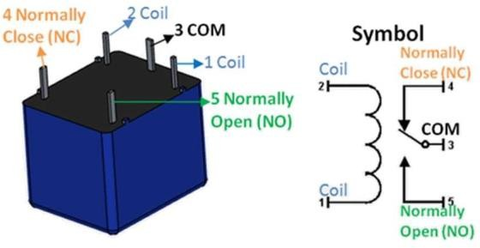
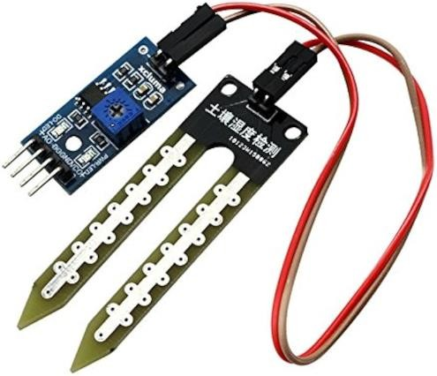
COMPONENTS REQUIRED
RELAY MODULE
SOIL MOISTURE SENSOR
PROJECT PHASE-I
ATME College of Engineering, Mysuru
Department of Electrical and Electronics Engineering, ATMECE, Mysuru

Slide 15
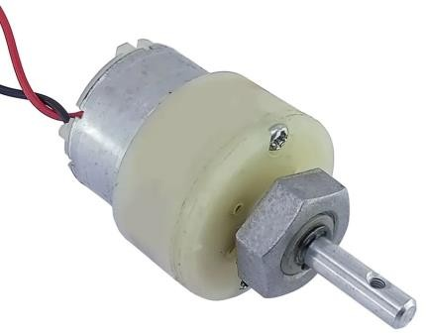
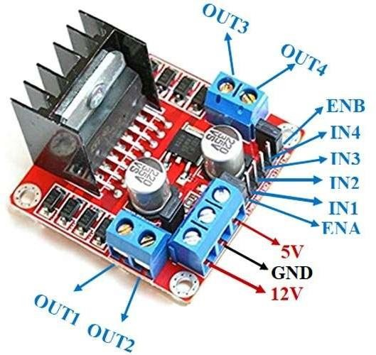
COMPONENTS REQUIRED
DC GEAR MOTOR
MOTOR DRIVER MODULE
PROJECT PHASE-I
ATME College of Engineering, Mysuru
Department of Electrical and Electronics Engineering, ATMECE, Mysuru
Notes:
Running RPM 100rpm
it had supplied 8.2 volt

Slide 16

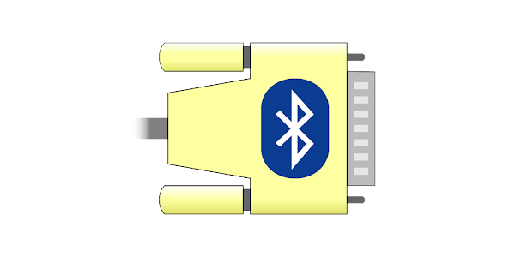

SOFTWARE TOOL
ARDUINO IDE
Bluetooth Serail Terminal
Google Sheets
PROJECT PHASE-I
ATME College of Engineering, Mysuru
Department of Electrical and Electronics Engineering, ATMECE, Mysuru

Slide 17
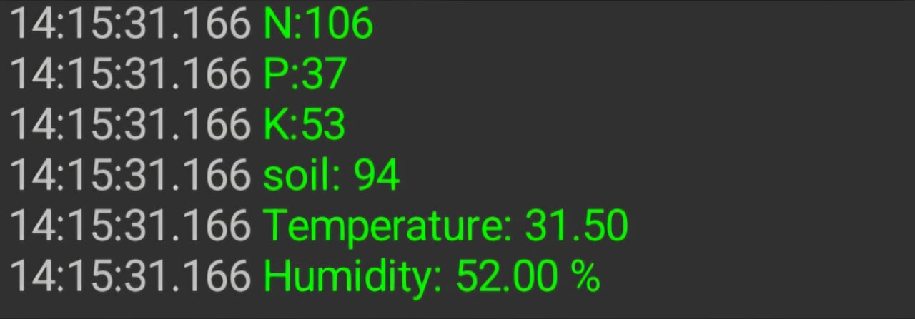
Experimental Result
Advantages
Coconut Tree
Coconut Trees :
Nitrogen (N): 87.5 kg/ha/year
Phosphorus (P): 56 kg/ha/year
Potassium (K): 210 kg/ha/year
Standard
Measured
PROJECT PHASE-I
ATME College of Engineering, Mysuru
Department of Electrical and Electronics Engineering, ATMECE, Mysuru

Slide 18
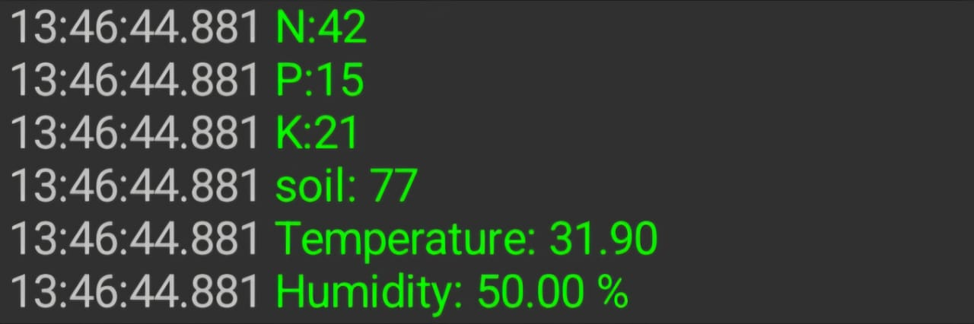
Experimental Result
Advantages
Brinjal Plant
NPK Value for Brinjal (per hectare)
Nitrogen (N): 100-125 kg/ha
Phosphorus (P): 50-60 kg/ha
Potassium (K): 50-75 kg/ha
Standard
Measured
PROJECT PHASE-I
ATME College of Engineering, Mysuru
Department of Electrical and Electronics Engineering, ATMECE, Mysuru

Slide 19
Advantages
Advantages
Optimized Resource Use
Enhanced Yields
Lower Labor Costs
Easy Scalability
Real-Time Response
PROJECT PHASE-I
ATME College of Engineering, Mysuru
Department of Electrical and Electronics Engineering, ATMECE, Mysuru

Slide 20
Applications
Soil and crop Monitoring
Precision Farming
Pest and Disease Control
Yield Prediction
PROJECT PHASE-I
ATME College of Engineering, Mysuru
Department of Electrical and Electronics Engineering, ATMECE, Mysuru

Slide 21
Future scope
Advanced Navigation
Weather Forecasting
Automated Crop Health Monitoring
Scalability for Large Farms
Integration with Fertilizer Dispensers
PROJECT PHASE-I
ATME College of Engineering, Mysuru
Department of Electrical and Electronics Engineering, ATMECE, Mysuru

Slide 22
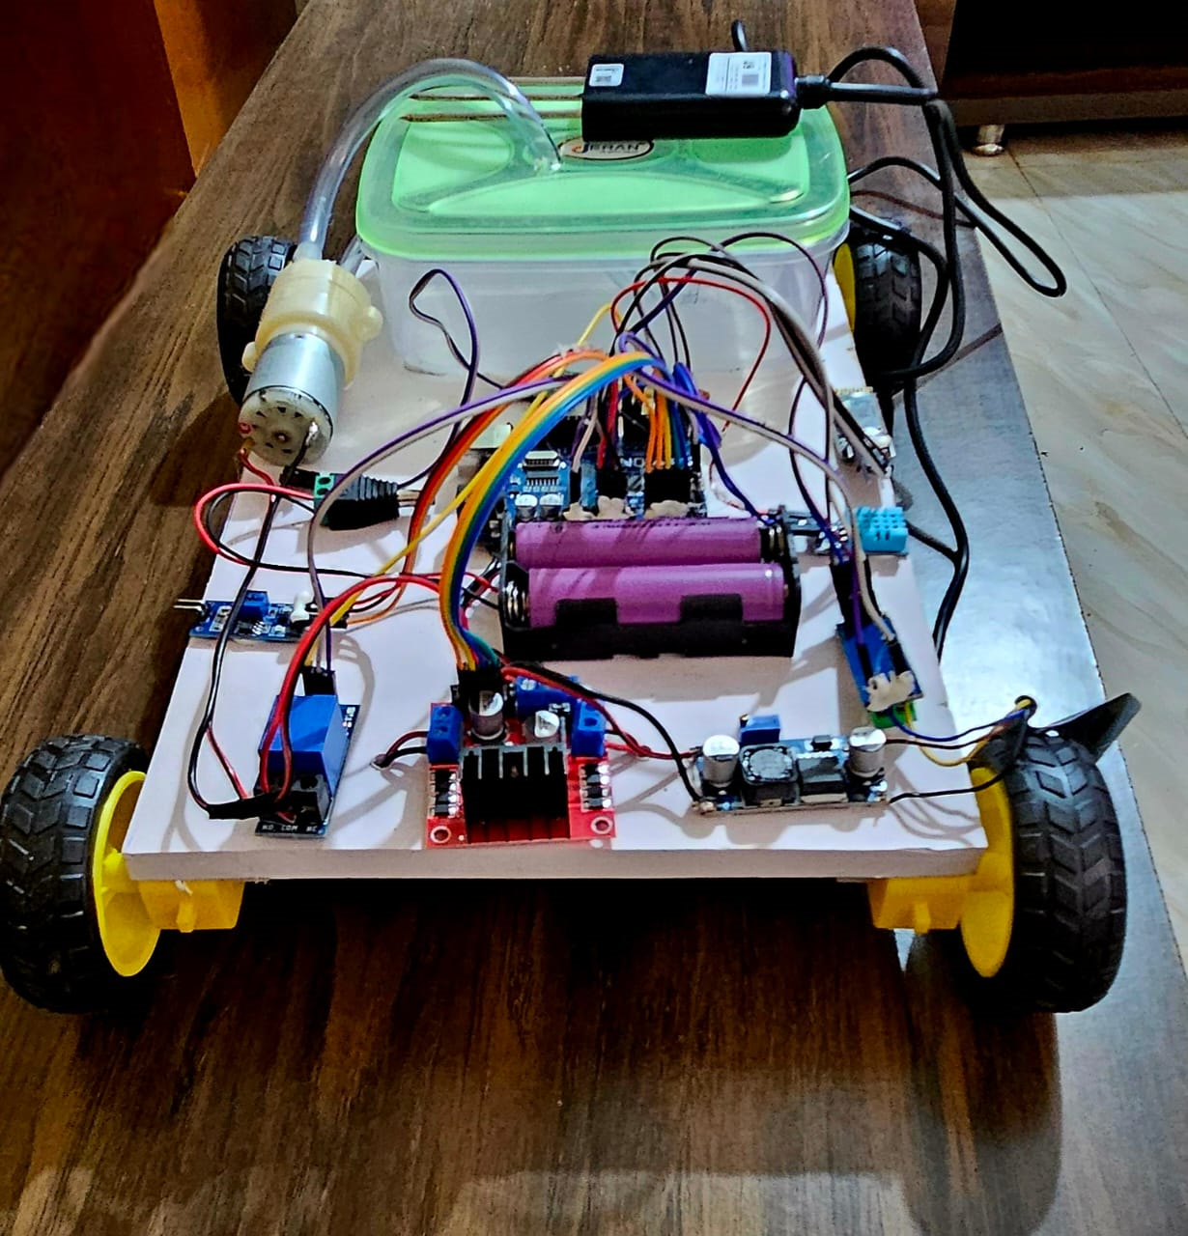
Proposed Model
PROJECT PHASE-I
ATME College of Engineering, Mysuru
Department of Electrical and Electronics Engineering, ATMECE, Mysuru

Slide 23
References
Smith, A , "Internet of Things for Precision Agriculture: Applications and Technologies," Journal of Agricultural Technology, 2018.
Johnson, B, "Big Data in Smart Farming – A Review," International Journal of Agricultural Data Science, 2019.
Patel, C, "Internet of Things-IoT: Definition, Characteristics, Architecture, Enabling Technologies, Application & Future Challenges," Journal of IoT Applications, 2020.
Wang, D, "IoT Based Monitoring System for Agriculture," International Journal of Smart Farming Systems, 2017.
Kumar, E, "A Review on the Practice of Big Data Analysis in Agriculture," Journal of Agricultural Data Analytics, 2021.
Lee, F, "Smart Irrigation System Based on Deep Learning Neural Network," Journal of Smart Irrigation Technology, 2019.
Green, G, "Smart Farming Revolution: Harnessing IoT for Enhanced Agricultural Yield and Sustainability," Sustainability in Agriculture Journal, 2022.
Singh, H, "Monitoring and Automation in Agriculture using IoT," Journal of Automation in Agriculture, 2020.
Martinez, I, "Review of IoT Applications in Agro-industrial and Environmental Fields," Journal of Agro-Environmental Technologies, 2021.
Zhao, J., "A Survey on Applications of IoT in Precision Agriculture," Journal of Precision Agriculture Technologies, 2019.
PROJECT PHASE-I
ATME College of Engineering, Mysuru
Department of Electrical and Electronics Engineering, ATMECE, Mysuru

Slide 24


